Slide 1
Lead Capture
How to use lead capture

Slide 2
TABLE OF CONTENTS
How to lead scan
What to lead scan
Options after scanning
How to use the leads dashboard
How to export the leads
About the leads excel

Slide 3
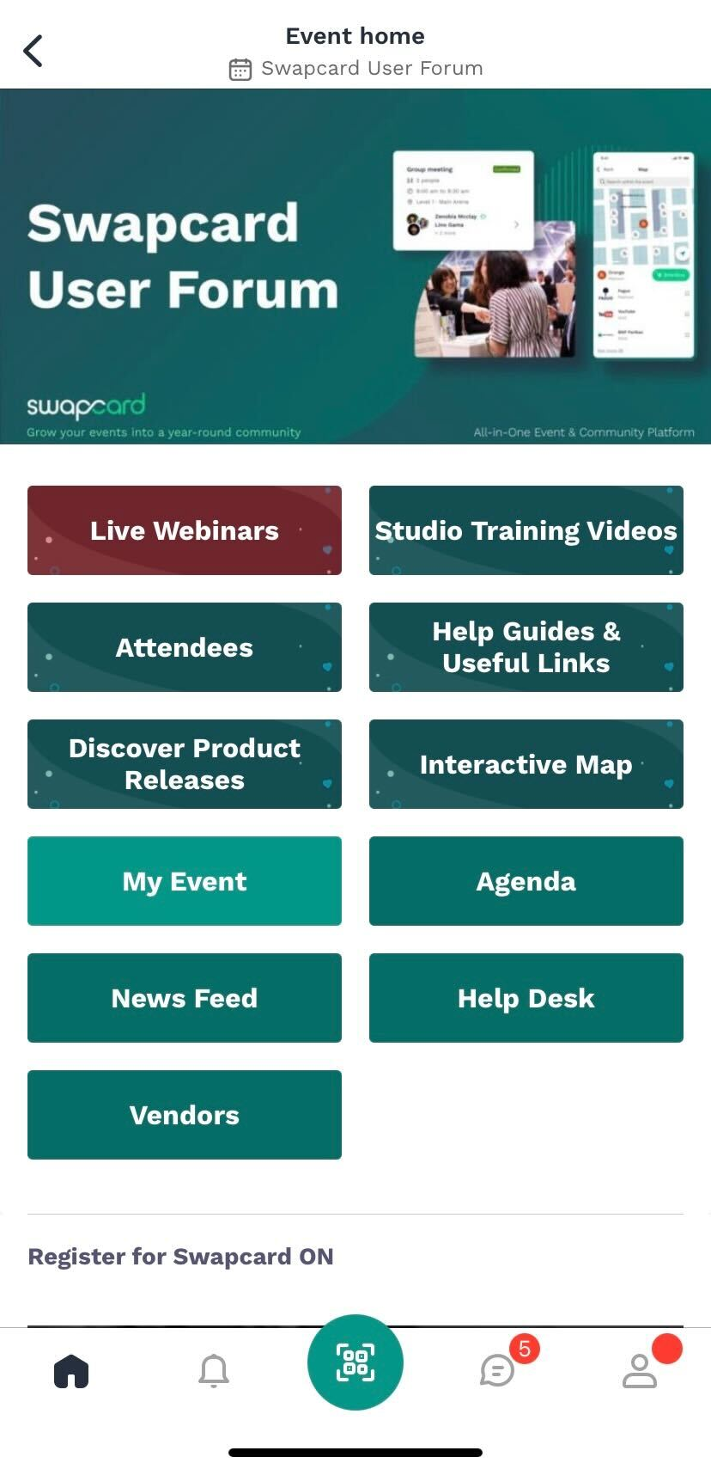
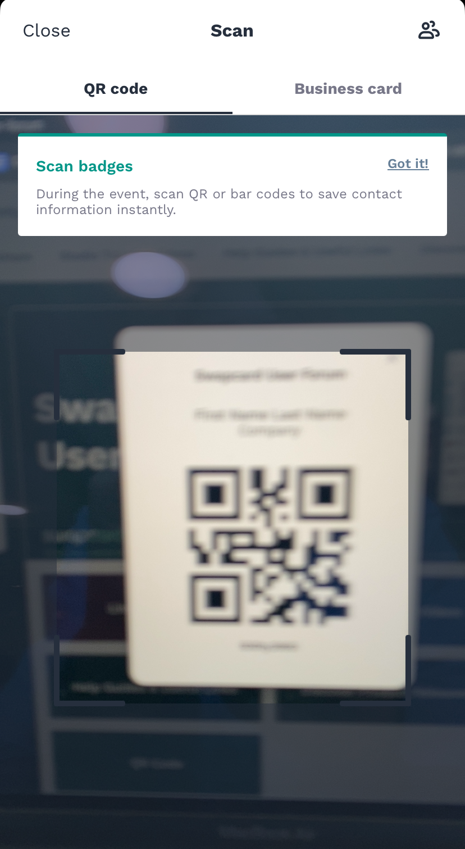
How to lead scan?
Open the app and click the scan icon on the bottom of the screen. This opens up a QR code/barcode scanner.

Slide 4
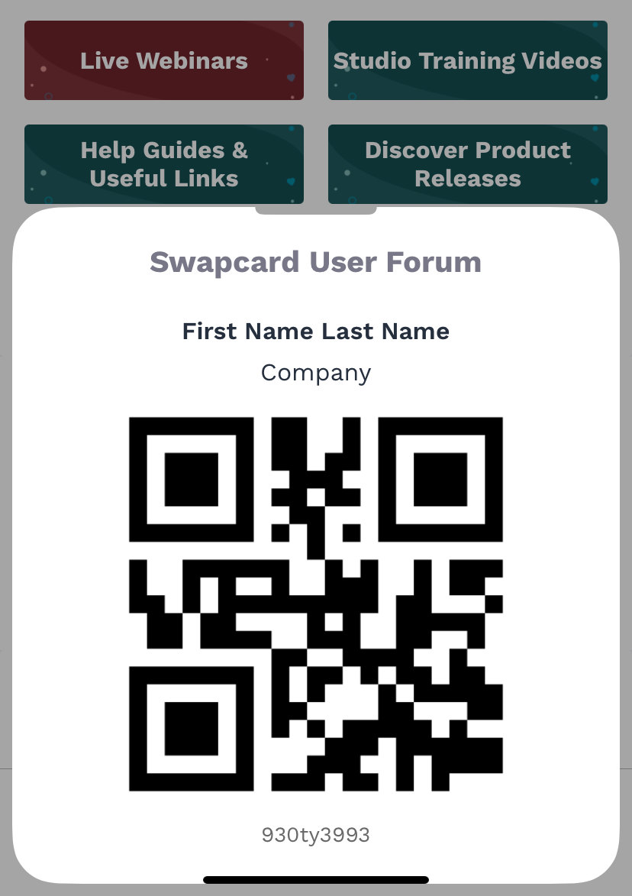
What to lead scan?
There are generally two options, depending on what the organizer decides to do:
1
Scan the QR code or barcode on a printed badge
(quickest method of scanning)
Scan the QR code or barcode from the Swapcard or Event app
(QR code is accessible from a button on the event home page)
2

Slide 5
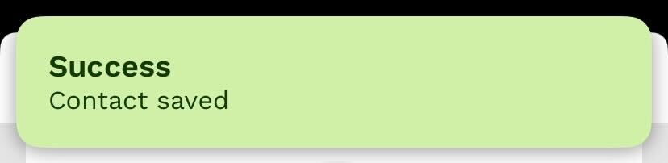
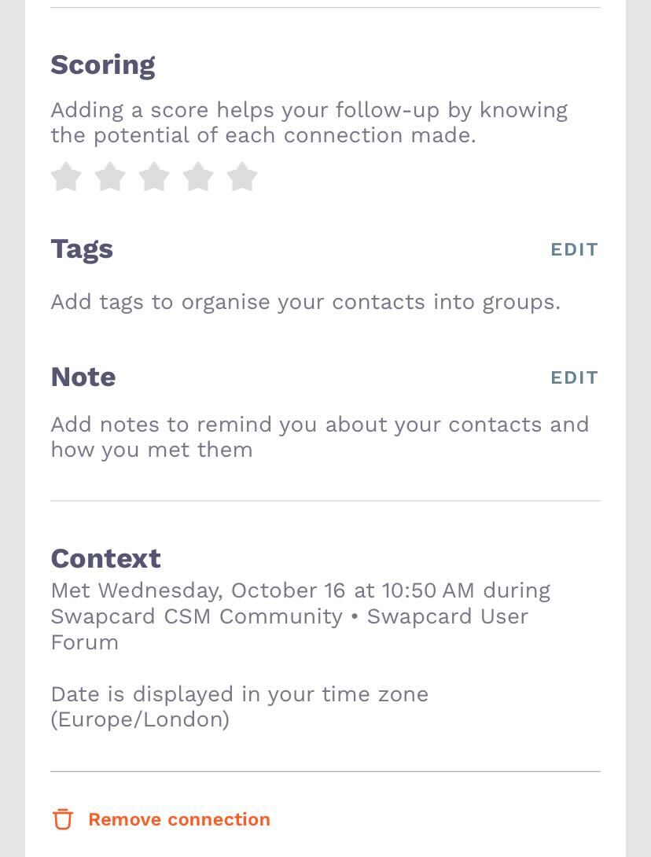
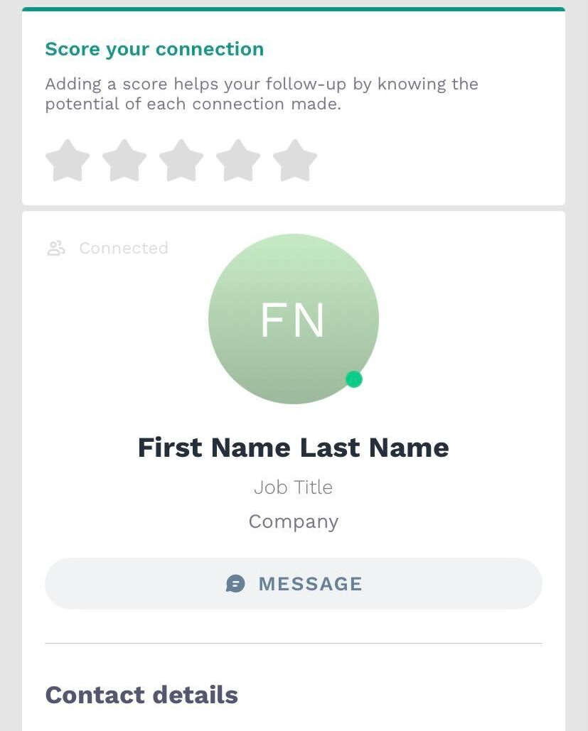
Options after scanning
1
A pop-up will tell you if the scan was successful.
2
Scanning automatically creates a connection between you and the person you scan. They will then land in your own contact list as well as the team’s contact list.
You can also export, print, or delete the contact and, if you have set up a Lead Qualification form, you can then add more details about this lead.
Note: All team members will use the same Lead Qualification form. We suggest having your primary point of contact set this up if you want to use this feature.
3

Slide 6
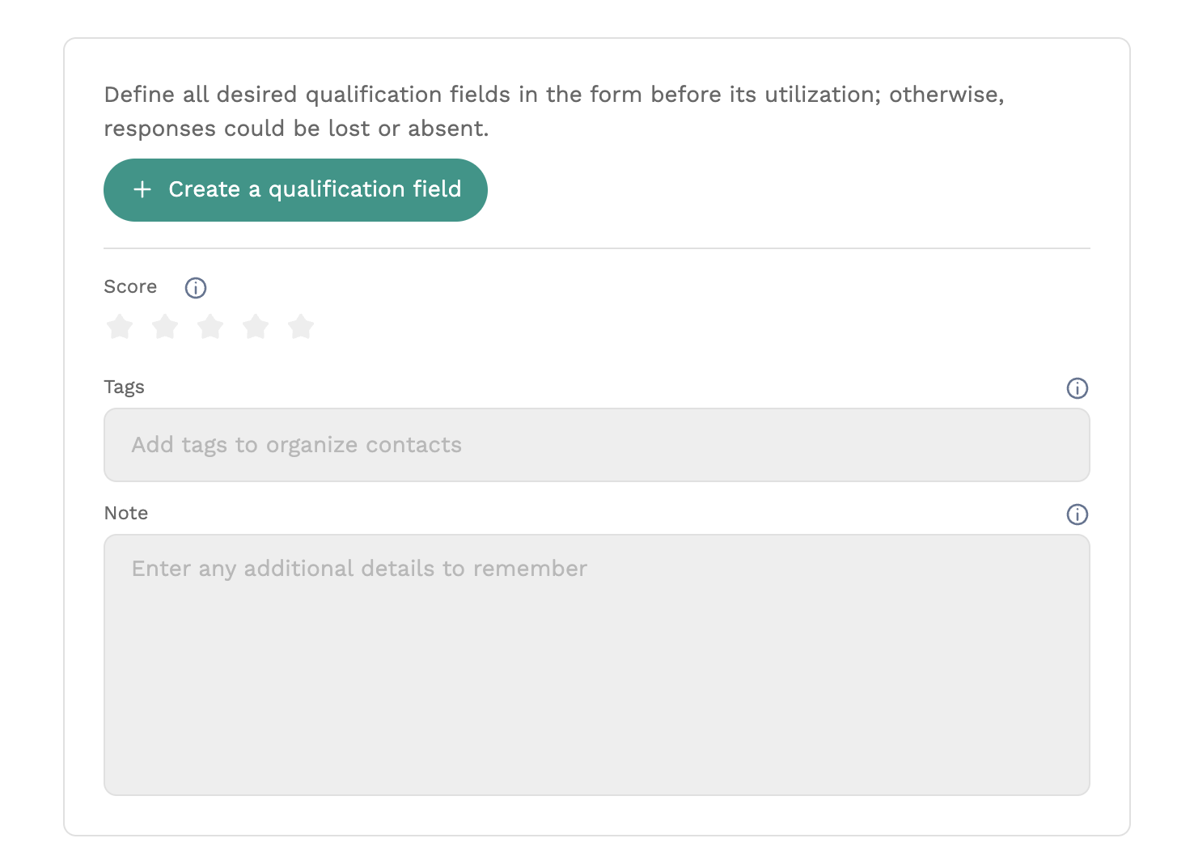
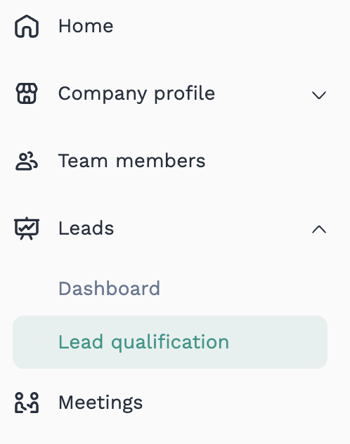
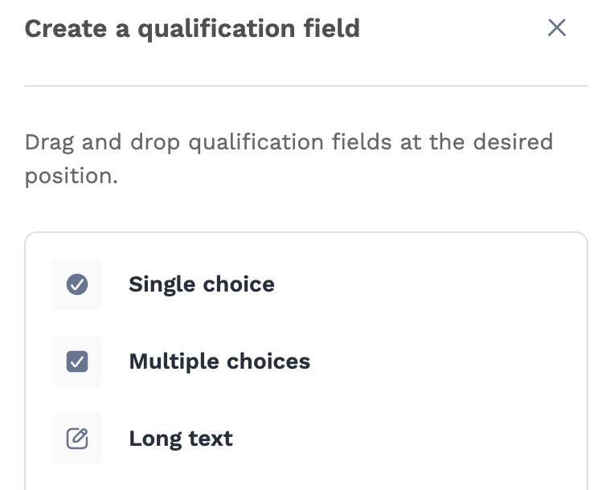
Create the Lead Qualification form
After accessing the Exhibitor Center, go to Leads and then Lead qualification.
Press the Customize lead qualification button.
Press the Create a qualification field button to start adding fields to your qualification form.
From the right-side panel, drag & drop the type of field you want to create to the form.
Press edit icon to rename the field and related option values (if single and multiple choices). You can also reorder your fields and delete them by clicking on the proper icon.
1
2
3
4
Note: All team members will use the same Lead Qualification form. We suggest having your primary point of contact set this up if you want to use this feature.
5
Note: Score and Tags are default qualifiers and can’t be deleted

Slide 7
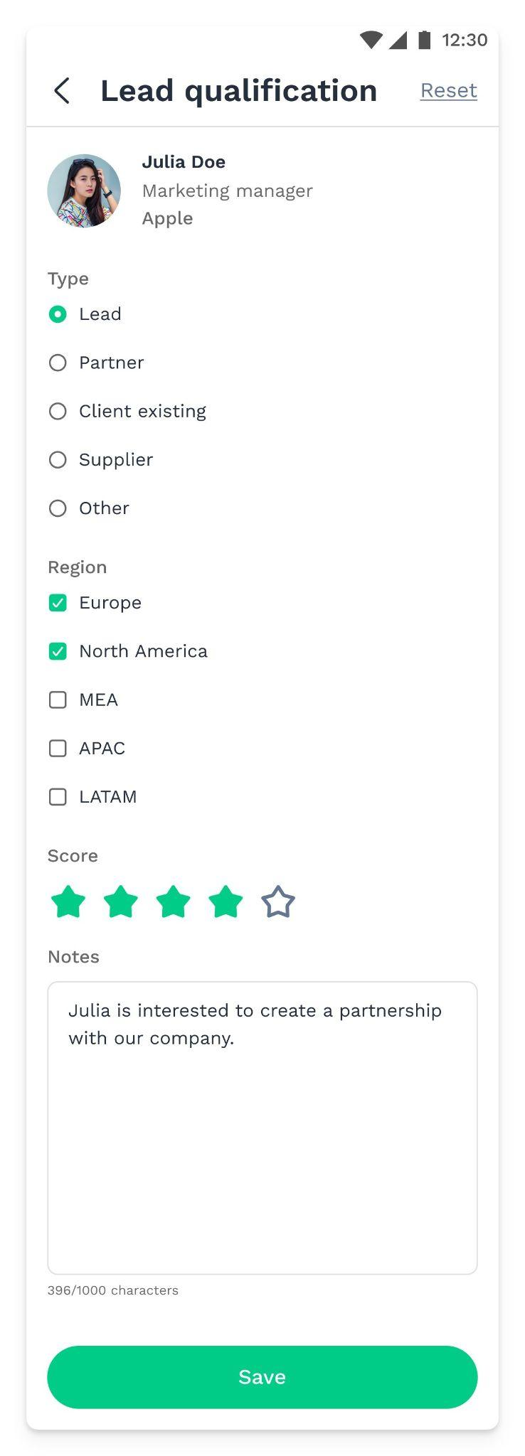
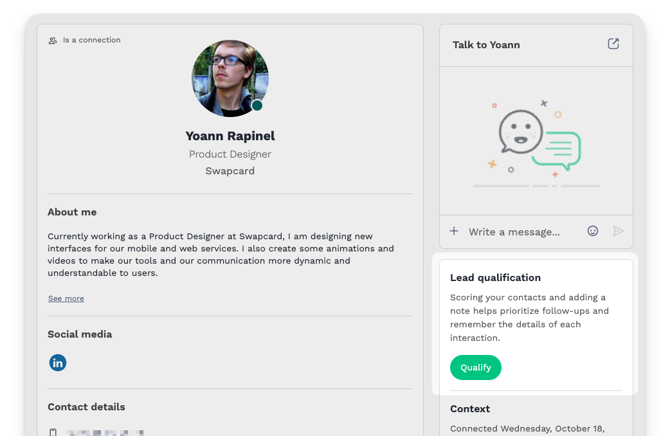
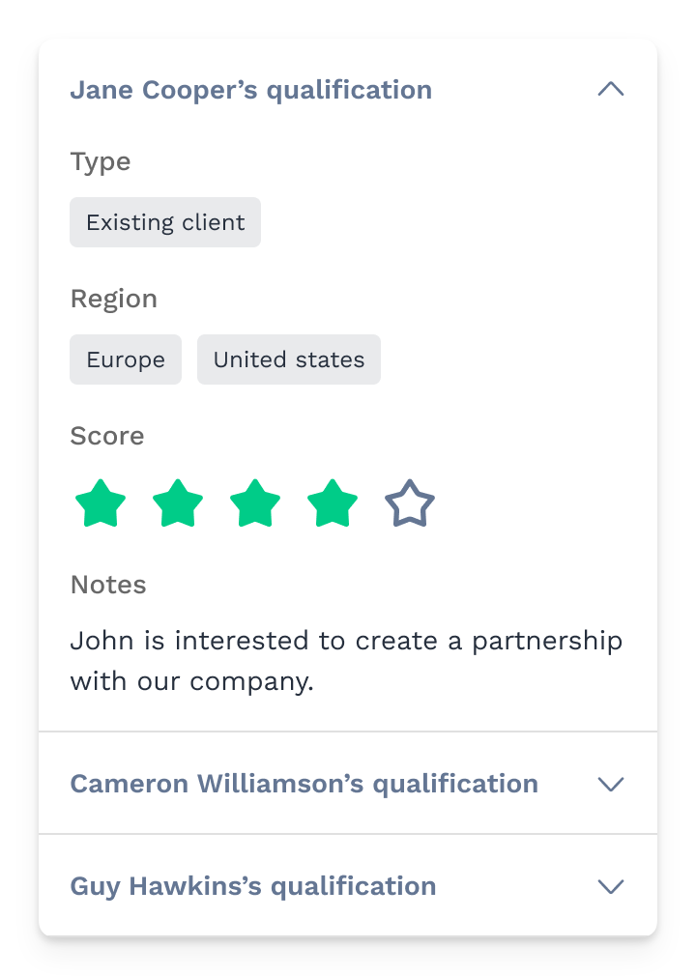
Qualify a contact using the Lead Qualification form
Following an accepted connection or meeting request, or after scanning their badge, you can qualify your contact.
From Web or Mobile app, navigate to the contact page and follow these steps:
Locate the Lead Qualification section and press Qualify
The shared qualification form you created will be accessible and fillable by all team members for each contact they meet at the event
You can view and add details to a contact already qualified by another team member
All team members' qualification responses will be included in the global export of your team's contacts
1
2
3
4

Slide 8
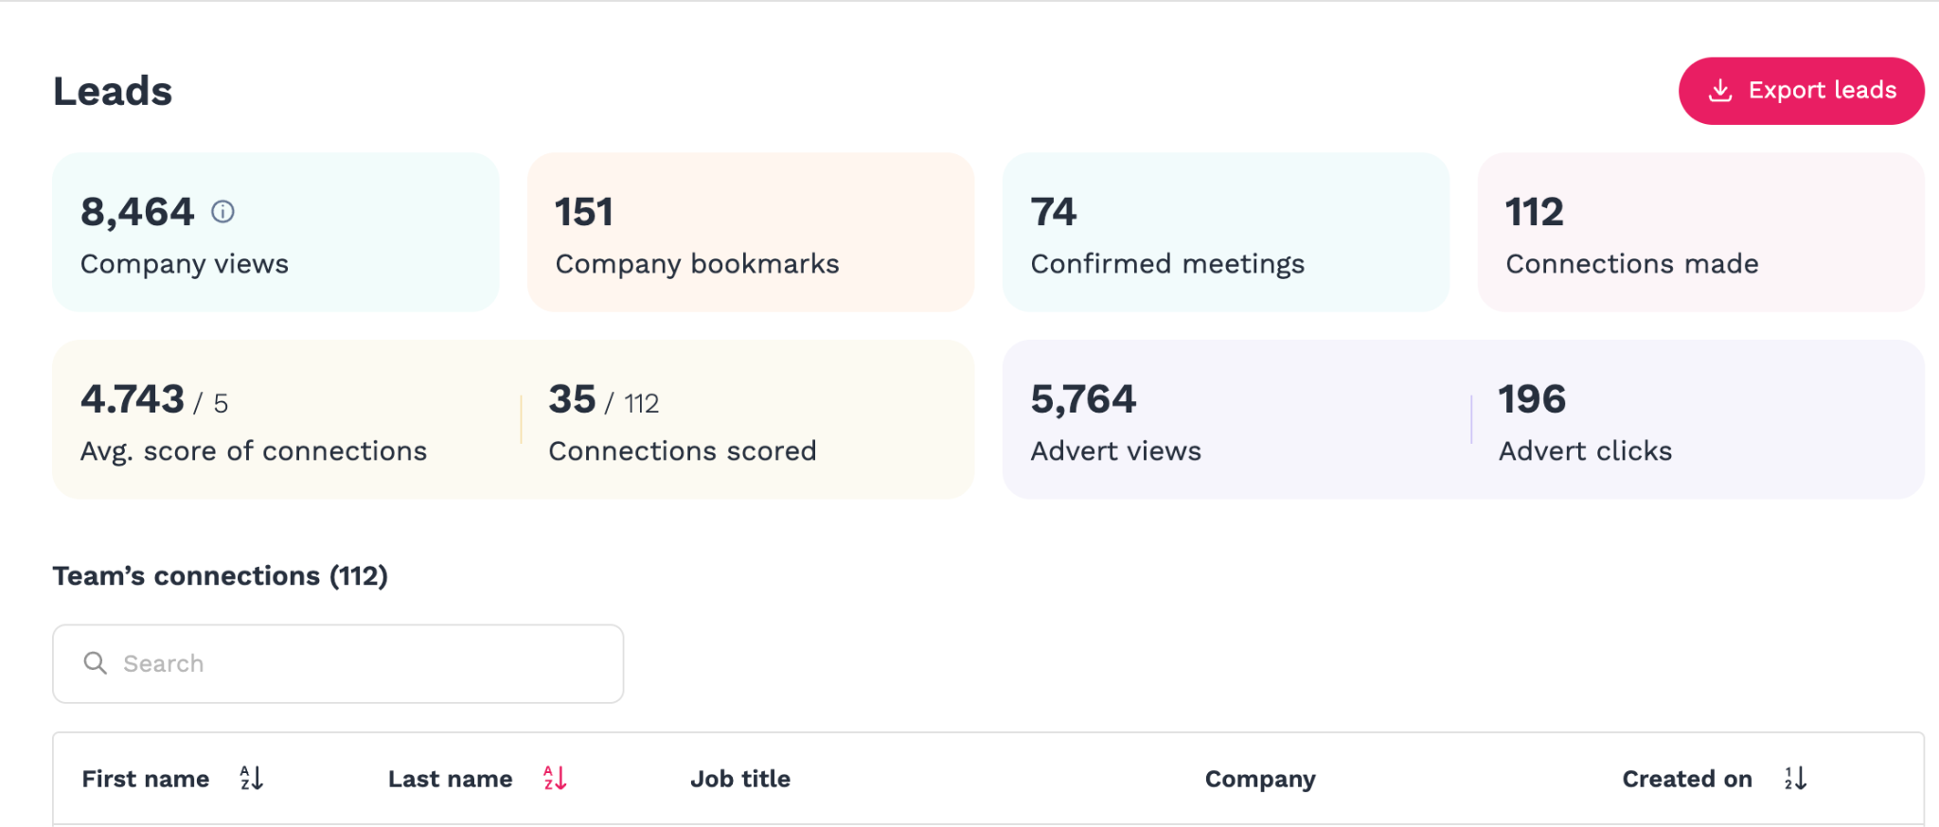
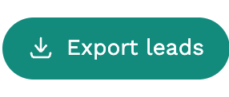
Leads dashboard
You can easily download and manage your leads from your computer at the Leads dashboard in the Exhibitor Center (team.swapcard.com/login).
Check some statistics about your company’s booth and your team’s activity
Download an Excel with the list of people your team interacted with.
Table with the contacts made by your fellow team members.

Slide 9
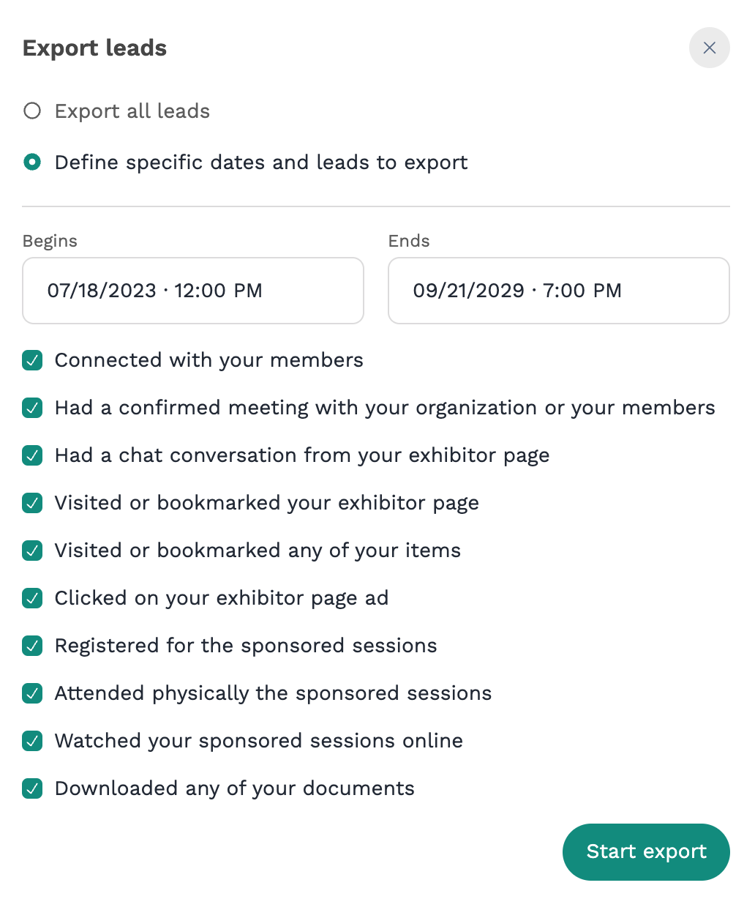
How to export the leads
You can easily download your leads from your computer accessing the Leads dashboard, in the Exhibitor Center.
Click on the Export leads button in the top right corner:
Select whether you want to export all leads or to filter them by date and/or lead type
1
2
Note: Some of these filters may not be available for your company. Please confirm with the organizer which ones are available according to your category of participation.

Slide 10
Leads excel export
The below tabs with the leads will show up in the exported Excel file :
Contacts: The list of people that connected with exhibitor members.
Meeting confirmed: The list of people who had a meeting with the exhibitor or its members.
Chat: The list of people who had a chat with the exhibitor in the exhibitor booth.

Slide 11
Thank you for taking the
time to read this presentation.
If needed assistance, please contact: Stephanie Batson | Sr. Manager, Exhibits sbatson@acep.org | 469-499-0174

