Slide 1

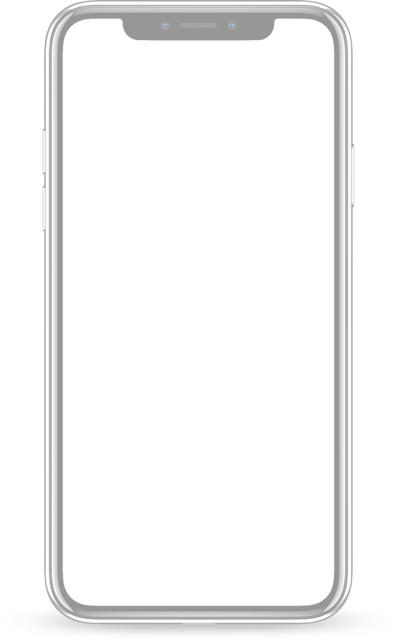
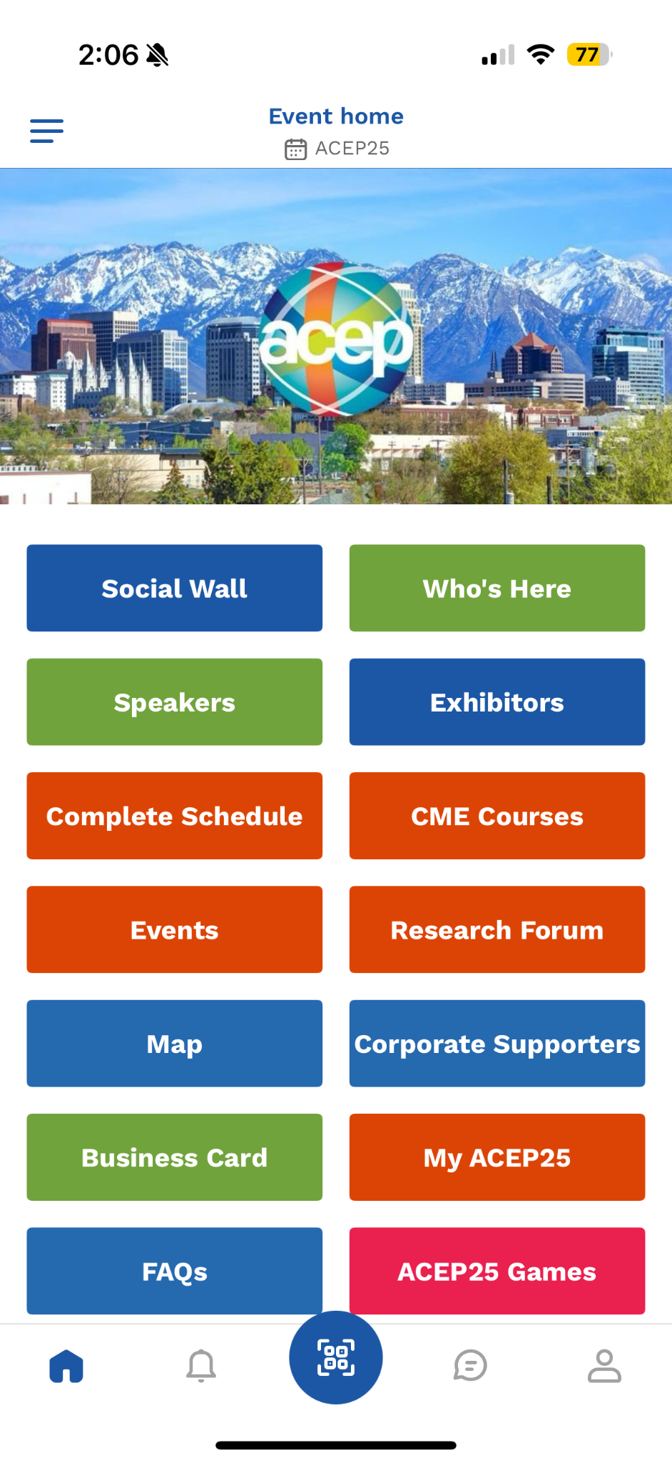
EXHIBITOR WEBINAR
ACEP 25

Slide 2
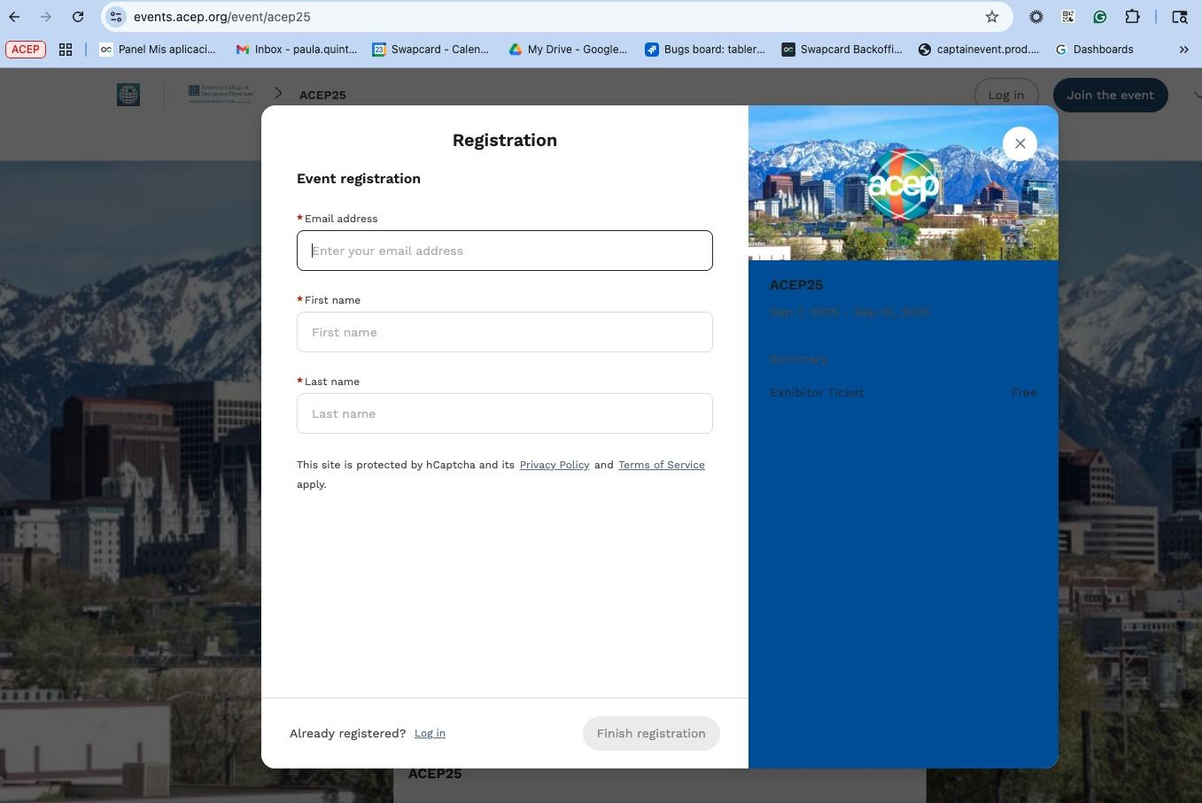
Register Your Booth Staff Option 1
(recommended):
Do it yourself rather than emailing them the registration link. This way you can 100% ensure that they’ll be registered and added to your team prior to ACEP25. Just follow these easy steps:
Send an email to all booth personnel to alert them that you’re registering them; let them know to expect the email on slide 4 (maybe put the screenshot of the slide in the email) and the directions they’ll need to follow within 48 hours of receiving the email
From your desktop, go to the registration link below and enter the details for your booth staff; you’ll do this once for each person and you must use the staff person’s actual email address https://events.acep.org/login/event/acep25/ticket/VGlja2V0VHlwZV82NDcwNQ==/page/UmVnaXN0cmF0aW9uRm9ybV81Mzc3Mg==
Once complete, go to https://events.acep.org and sign on using your ACEP.org Single Sign On (SSO) that you set up when downloading the app on your device
Once signed on, you’ll enter your company’s exhibitor center by following the directions on slide 5
You’ll then need to officially add this person to your team by clicking on Team Members in the left navigation, then click Add a Member in the right navigation
Enter the email address of the team member and click Add Member
You’re done!

Slide 3
Register Your Booth Staff Option 2:
Have your booth staff register themselves by emailing them the registration link. Just follow these steps:
Send all your booth staff the registration link below and tell them to enter their details to register; let them know that once they take this step, they’ll need to let you know that it’s done so you can complete your next steps in bullets 3-6 https://events.acep.org/login/event/acep25/ticket/VGlja2V0VHlwZV82NDcwNQ==/page/UmVnaXN0cmF0aW9uRm9ybV81Mzc3Mg==
Let them know that once they register, they’ll receive the email on slide 4 (maybe put the screenshot of the slide in the email) and the directions they’ll need to follow within 48 hours of receiving the email
Once your staff confirm that they’ve completed the registration, you’ll go to https://events.acep.org and sign on using your ACEP.org Single Sign On (SSO) that you set up when downloading the app on your own device
Once signed on, you’ll enter your company’s exhibitor center by following the directions on slide 5
You’ll then need to officially add this person to your team by clicking on Team Members in the left navigation, then click Add a Member in the right navigation
Enter the email address of the team member and click Add Member
You’re done!

Slide 4
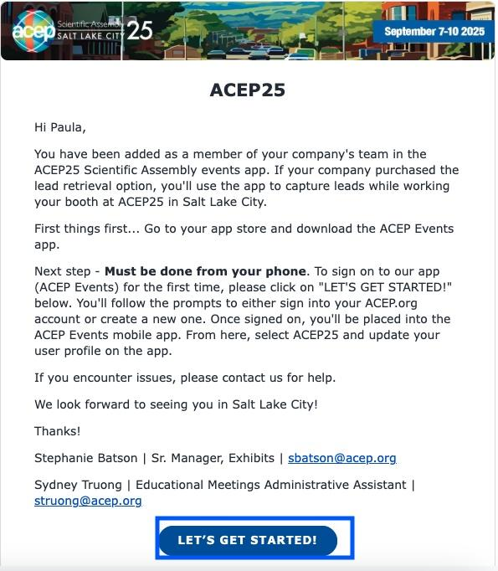
How to log in?
From your mobile device:
Download the ACEP Events mobile app from your device’s app store
Click on the “Let’s get started” button
Sign on to the mobile app using your ACEP.org username/password, OR if you don’t have one, create a ACEP.org username/password
Select ACEP25 and update your user profile

Slide 5
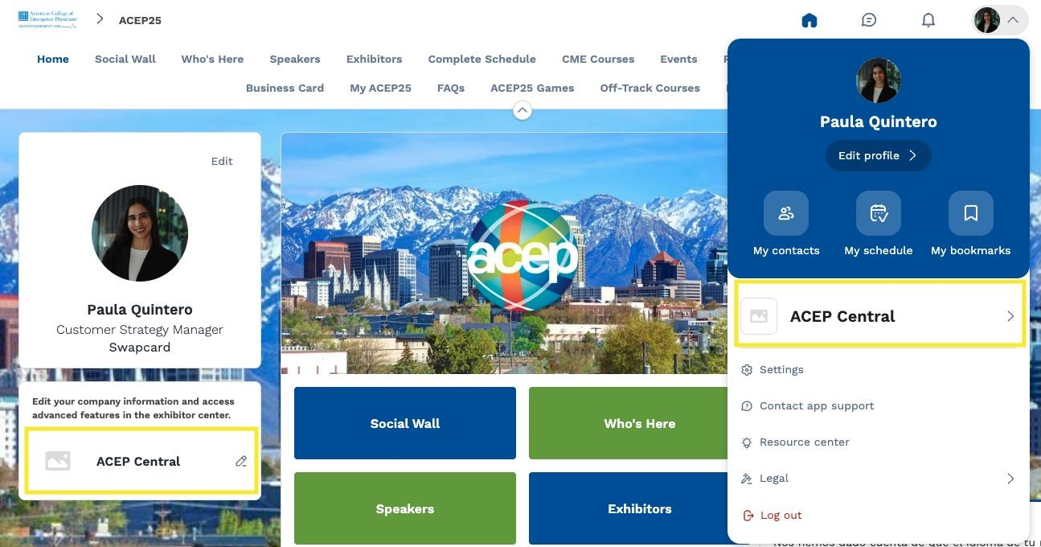
Access the Exhibitor Center: Web

Slide 6
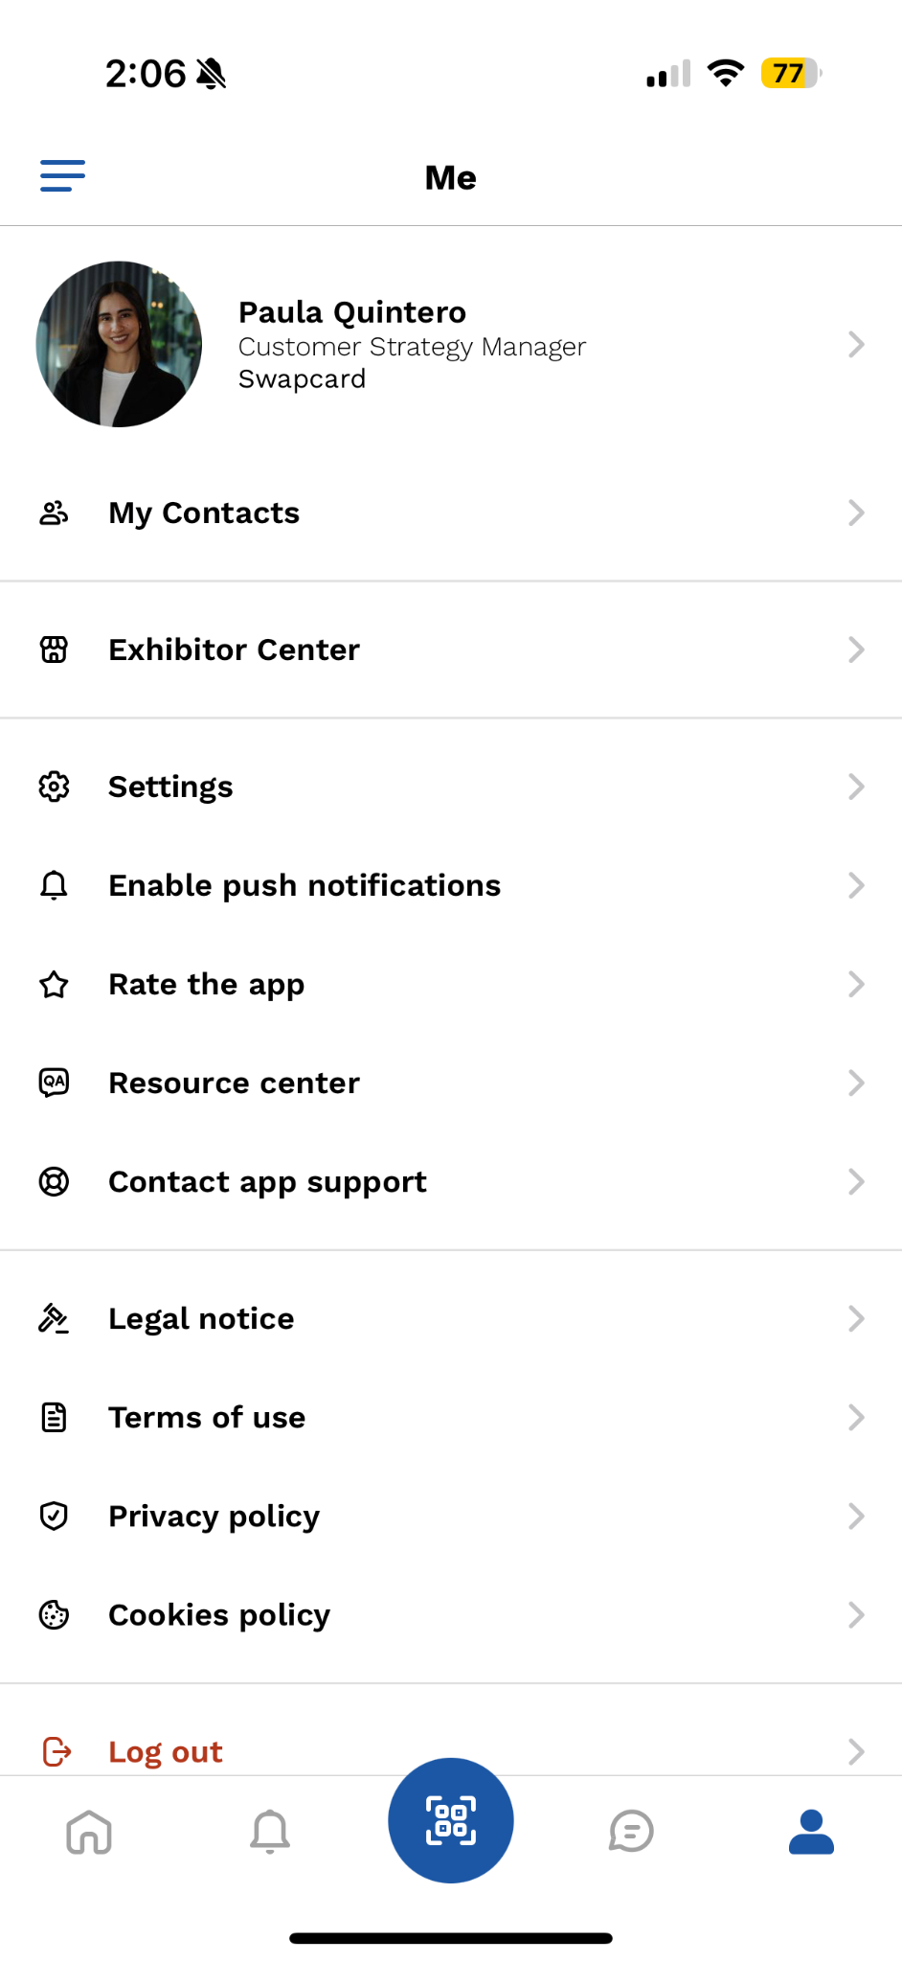
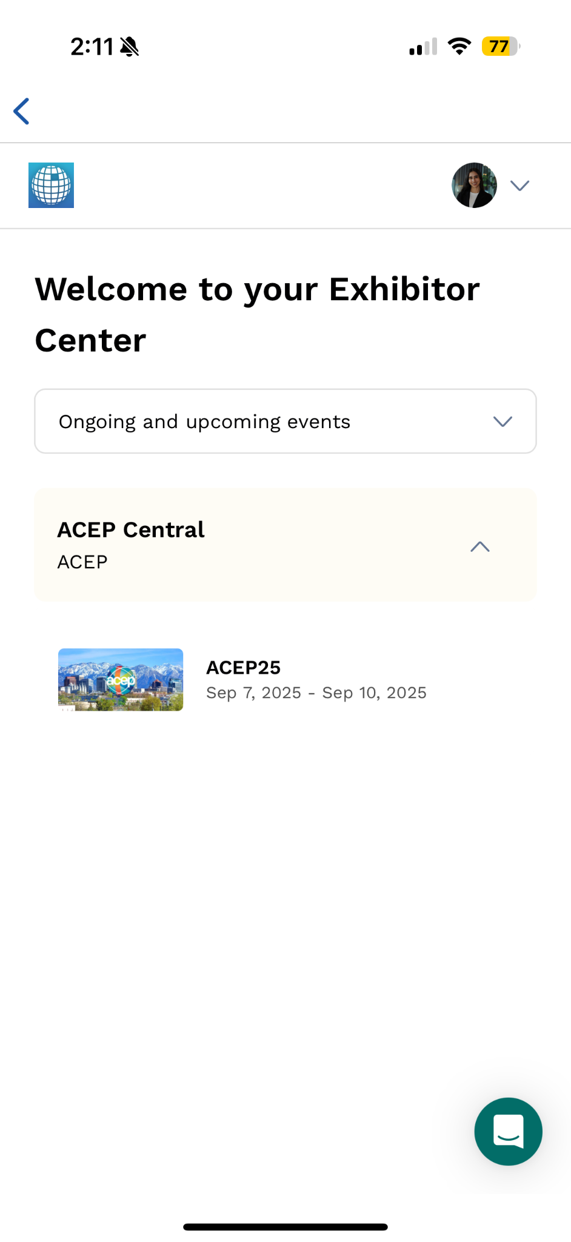
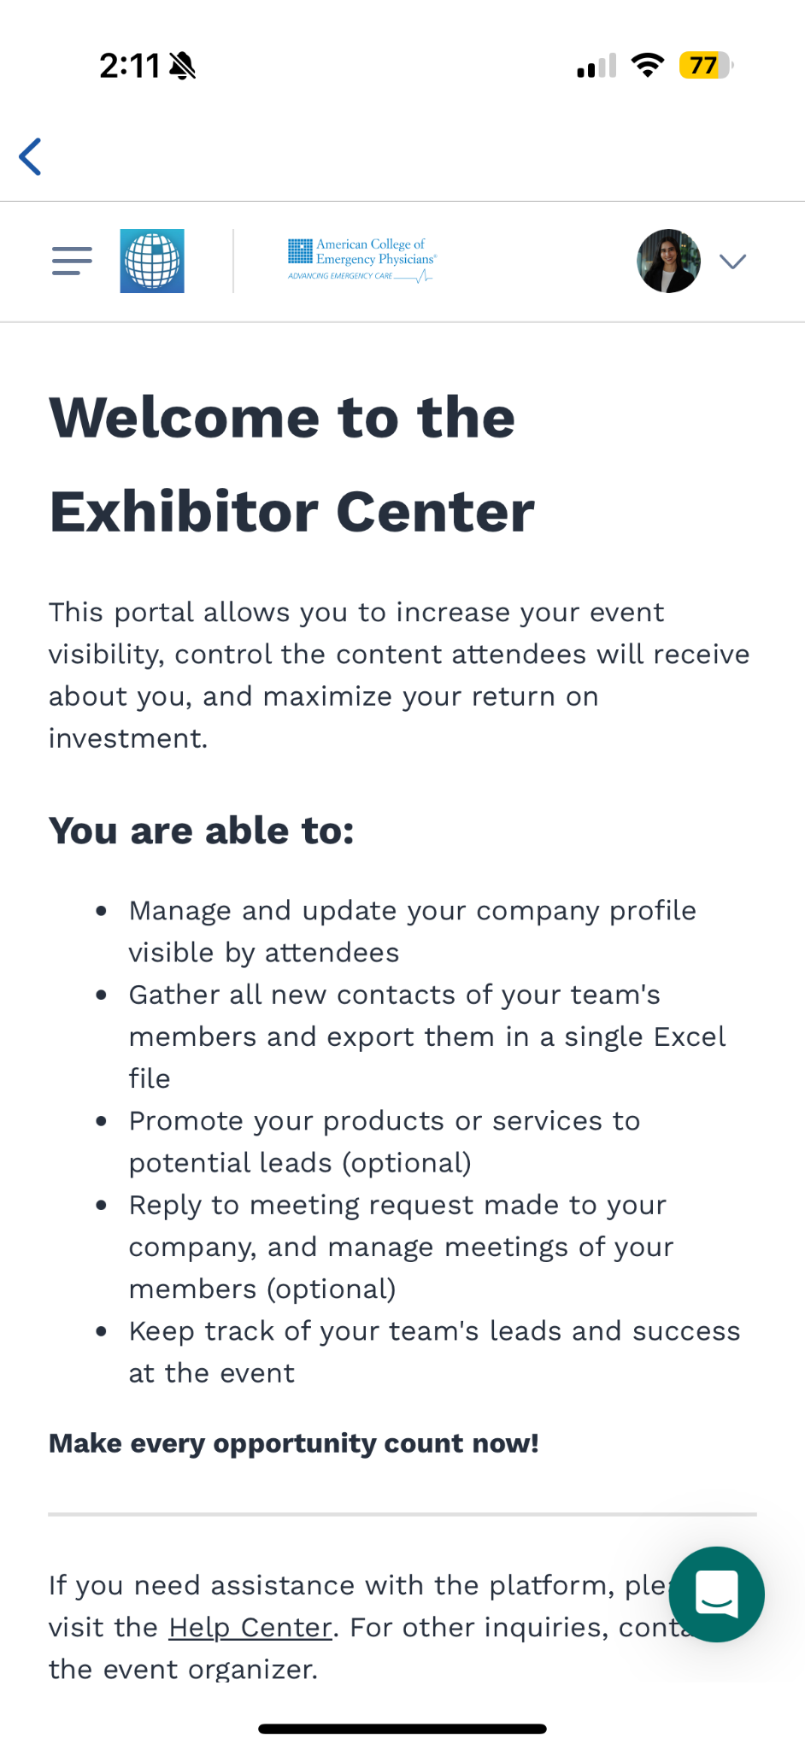
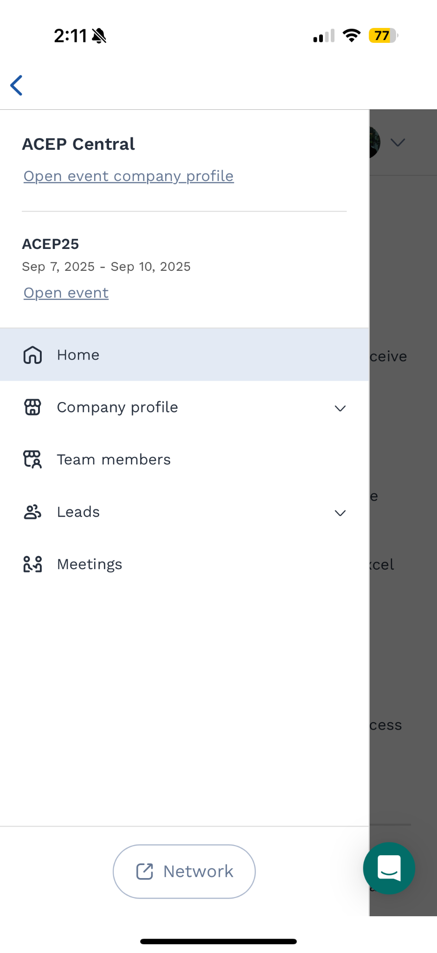
Access the Exhibitor Center: Mobile
1. Click on ‘Exhibitor Center’
2. Select the event
3. Click on the menu icon in the top left
4. Click on Company Profile

Slide 7
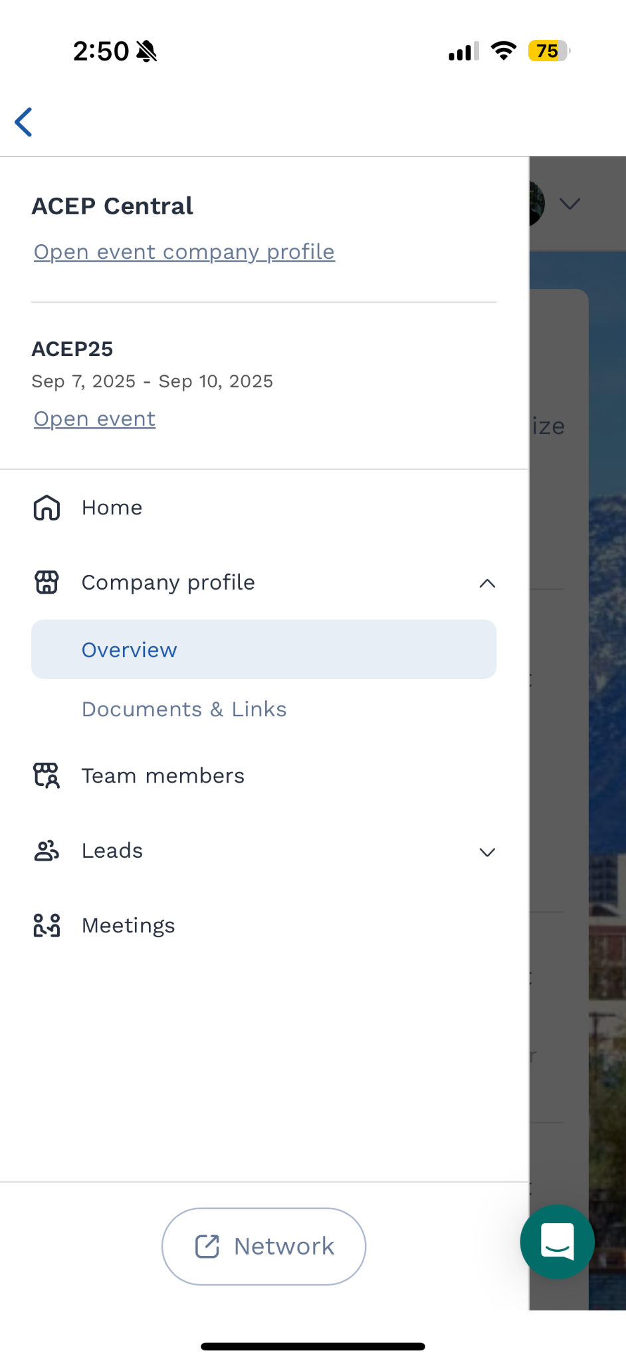
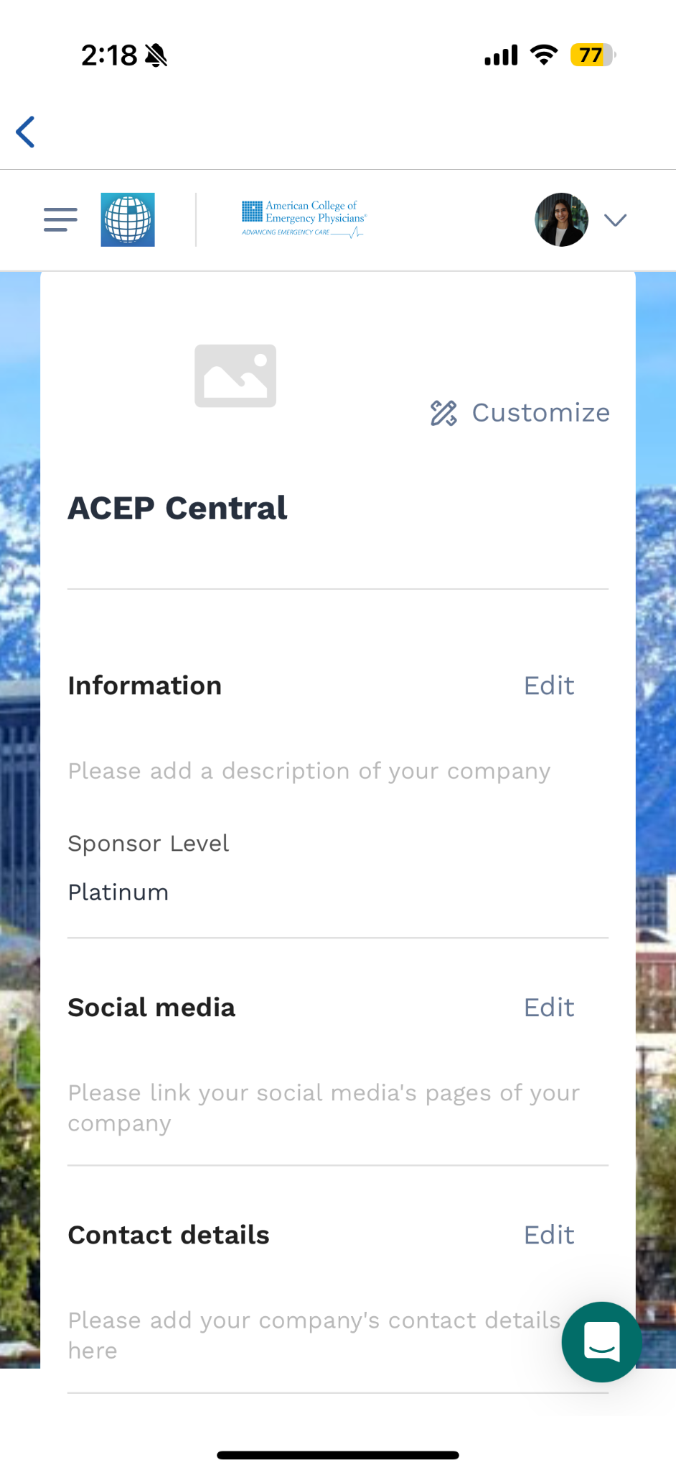
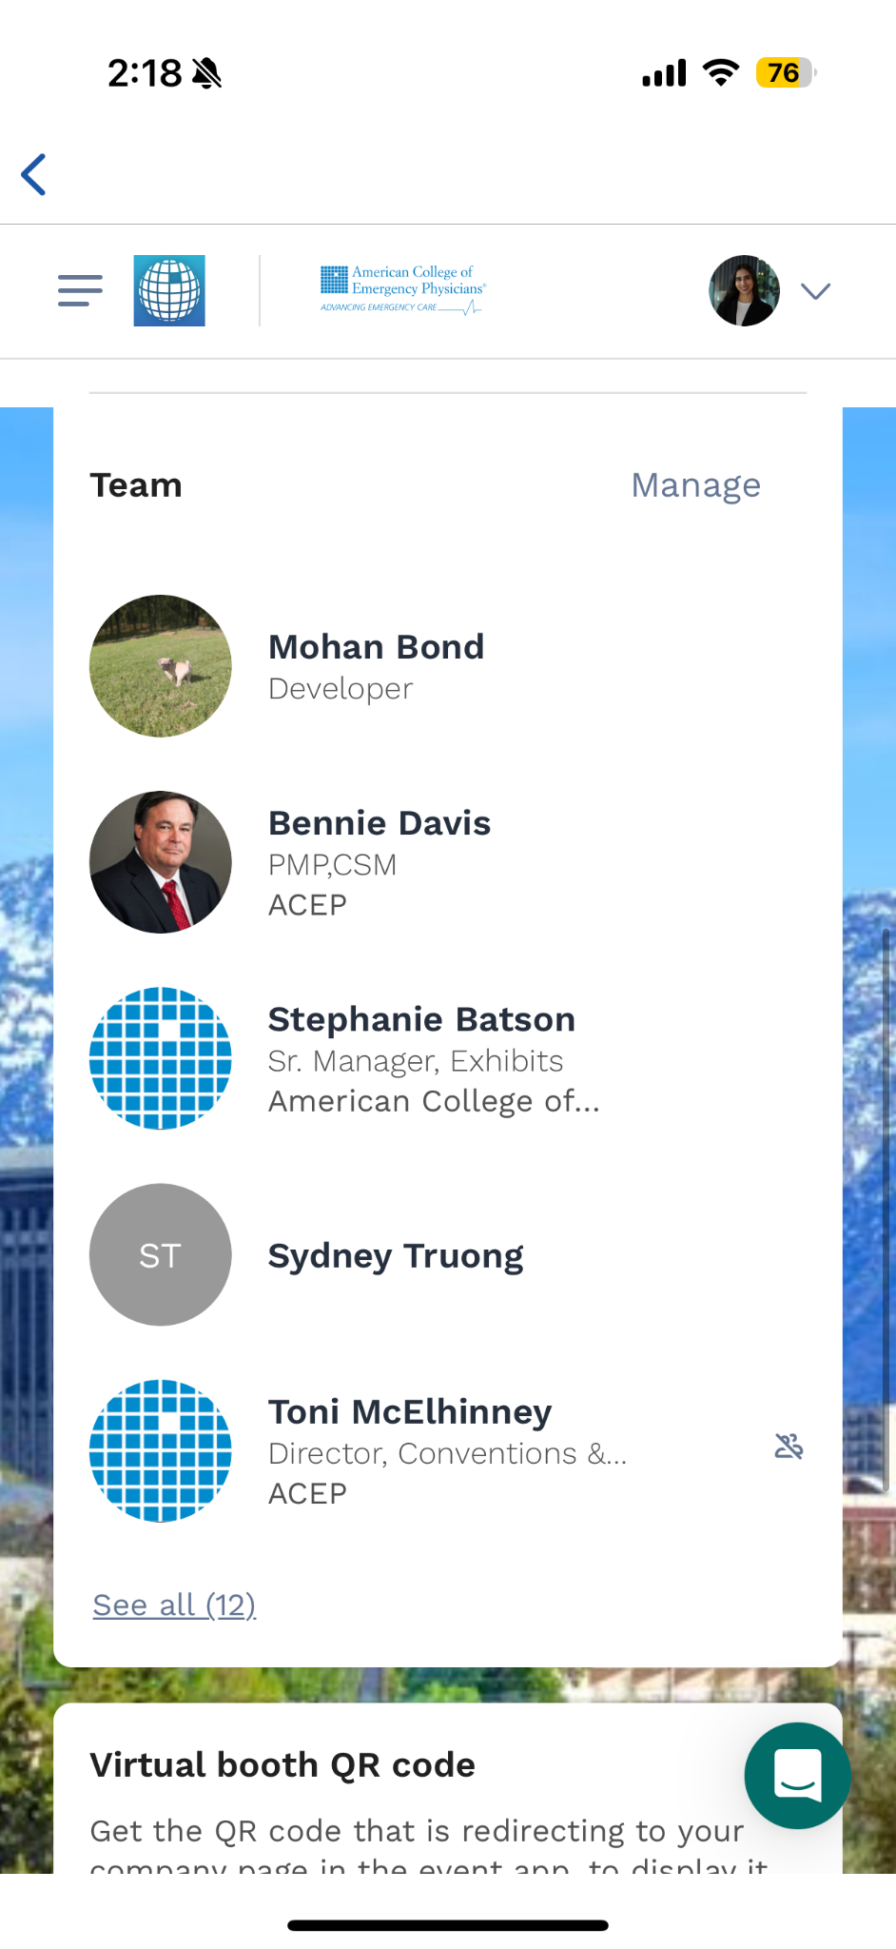
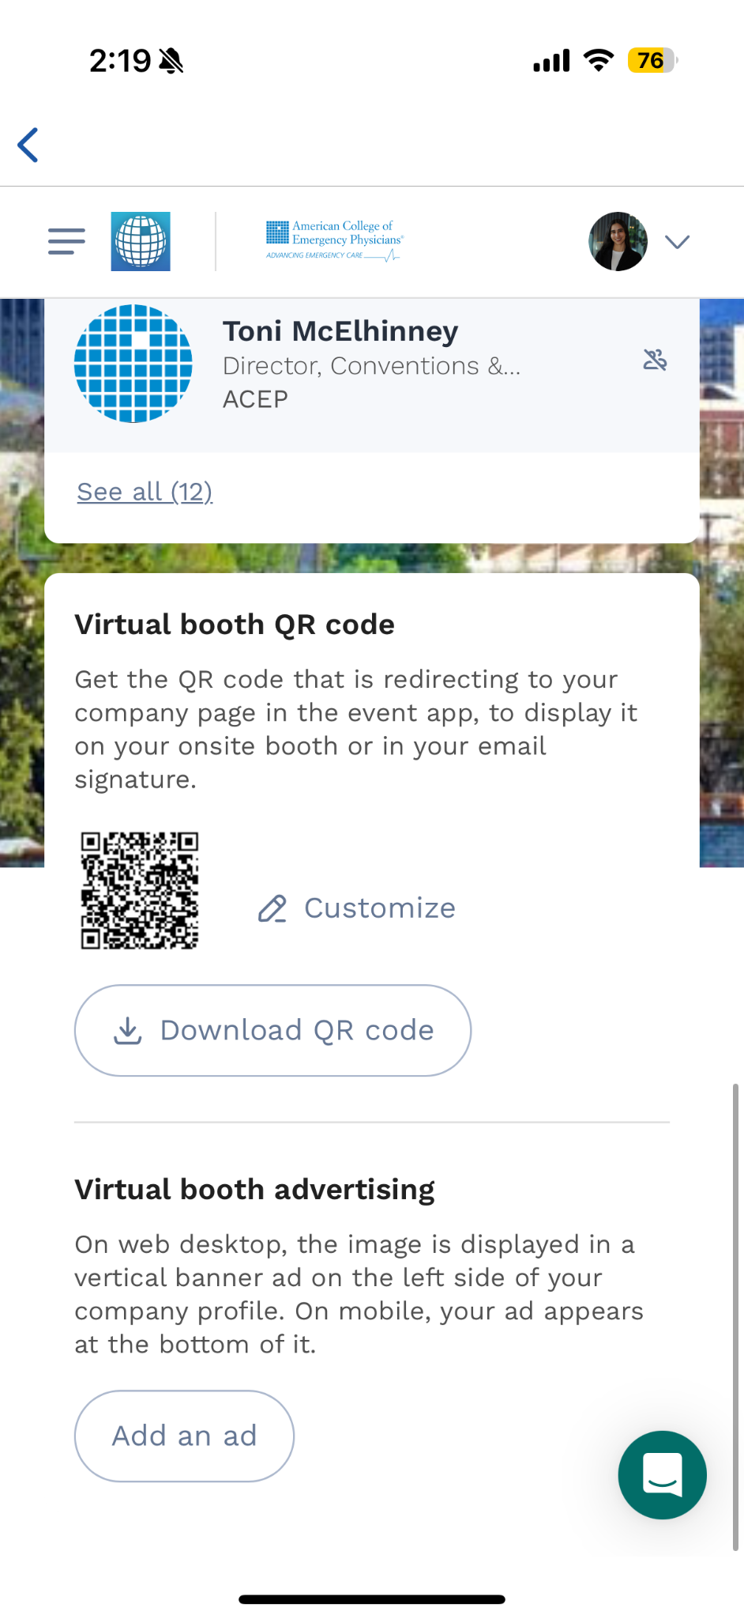
Exhibitor Center: Company profile
1. Click on ‘Company profile’ and then on ‘Overview’
2. Update your information, social media and contact details
3. Click on ‘Manage’ to review the team members
4. Download the QR code and add an ad

Slide 8
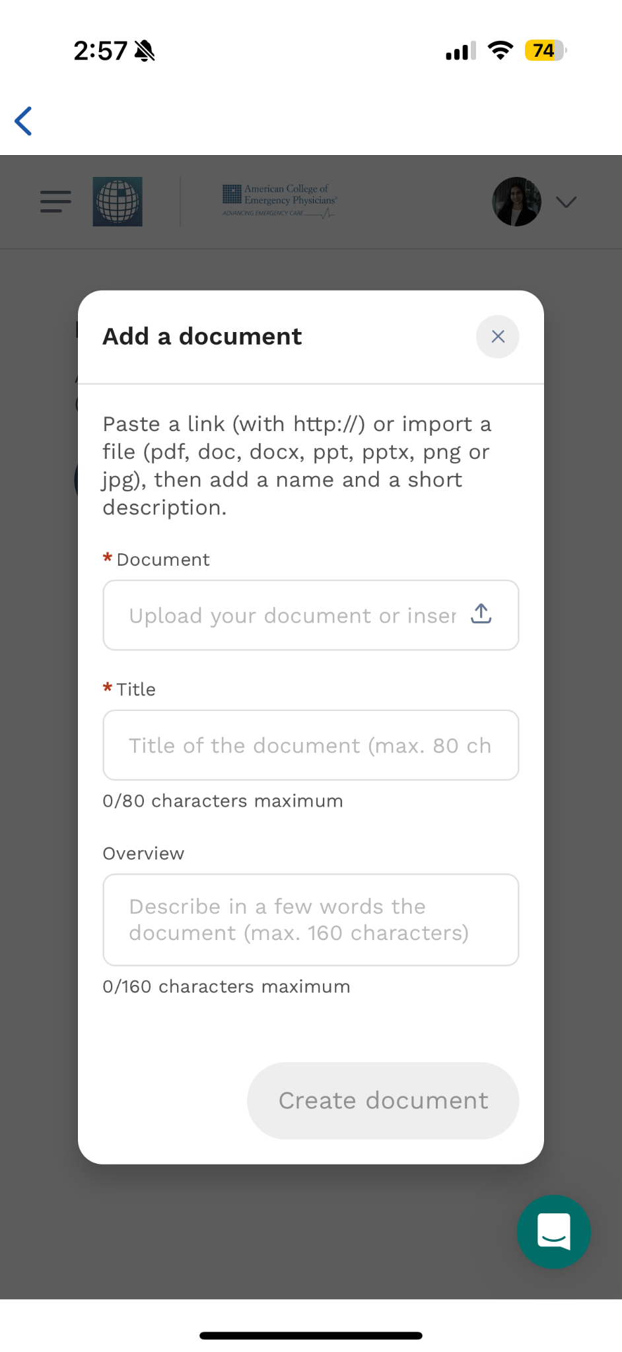
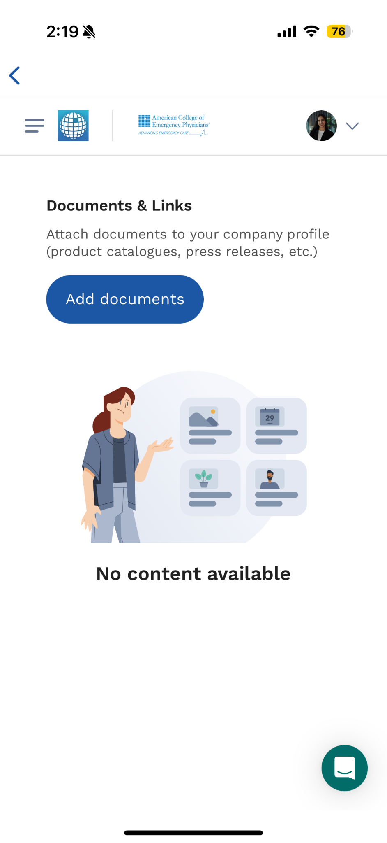
Exhibitor Center: Documents and links
1. Click on ‘Documents and links’
2. Click on ‘Add document’
3. Paste a link or import a file

Slide 9
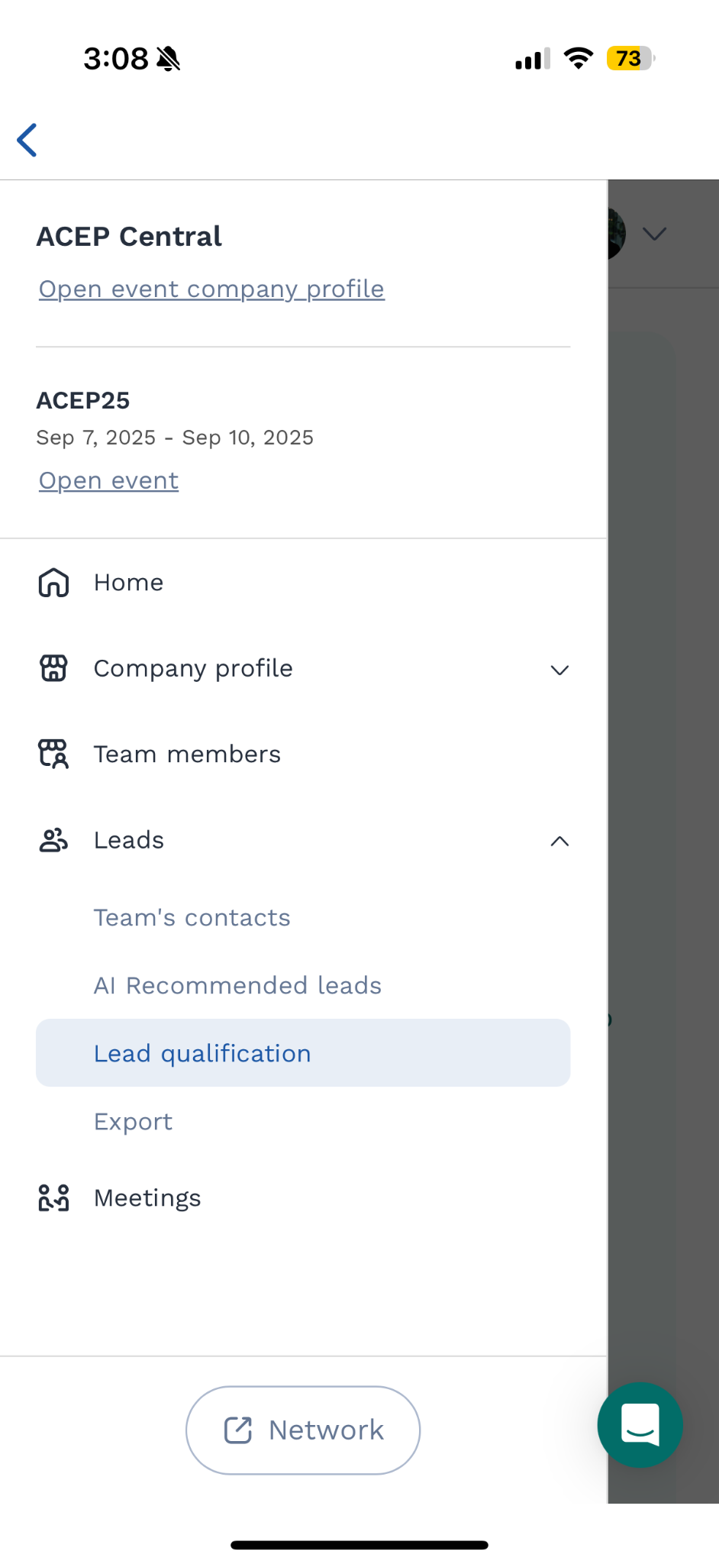
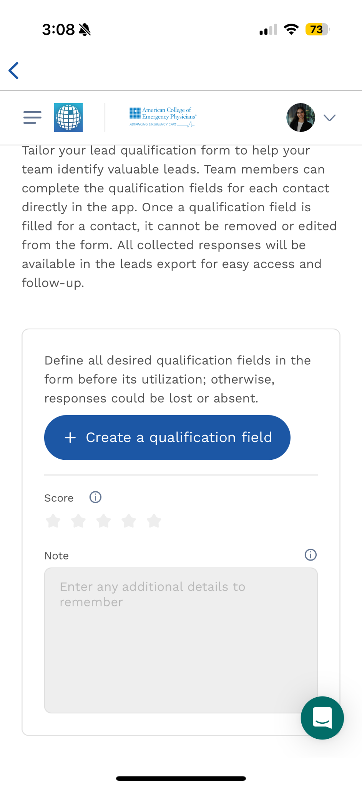
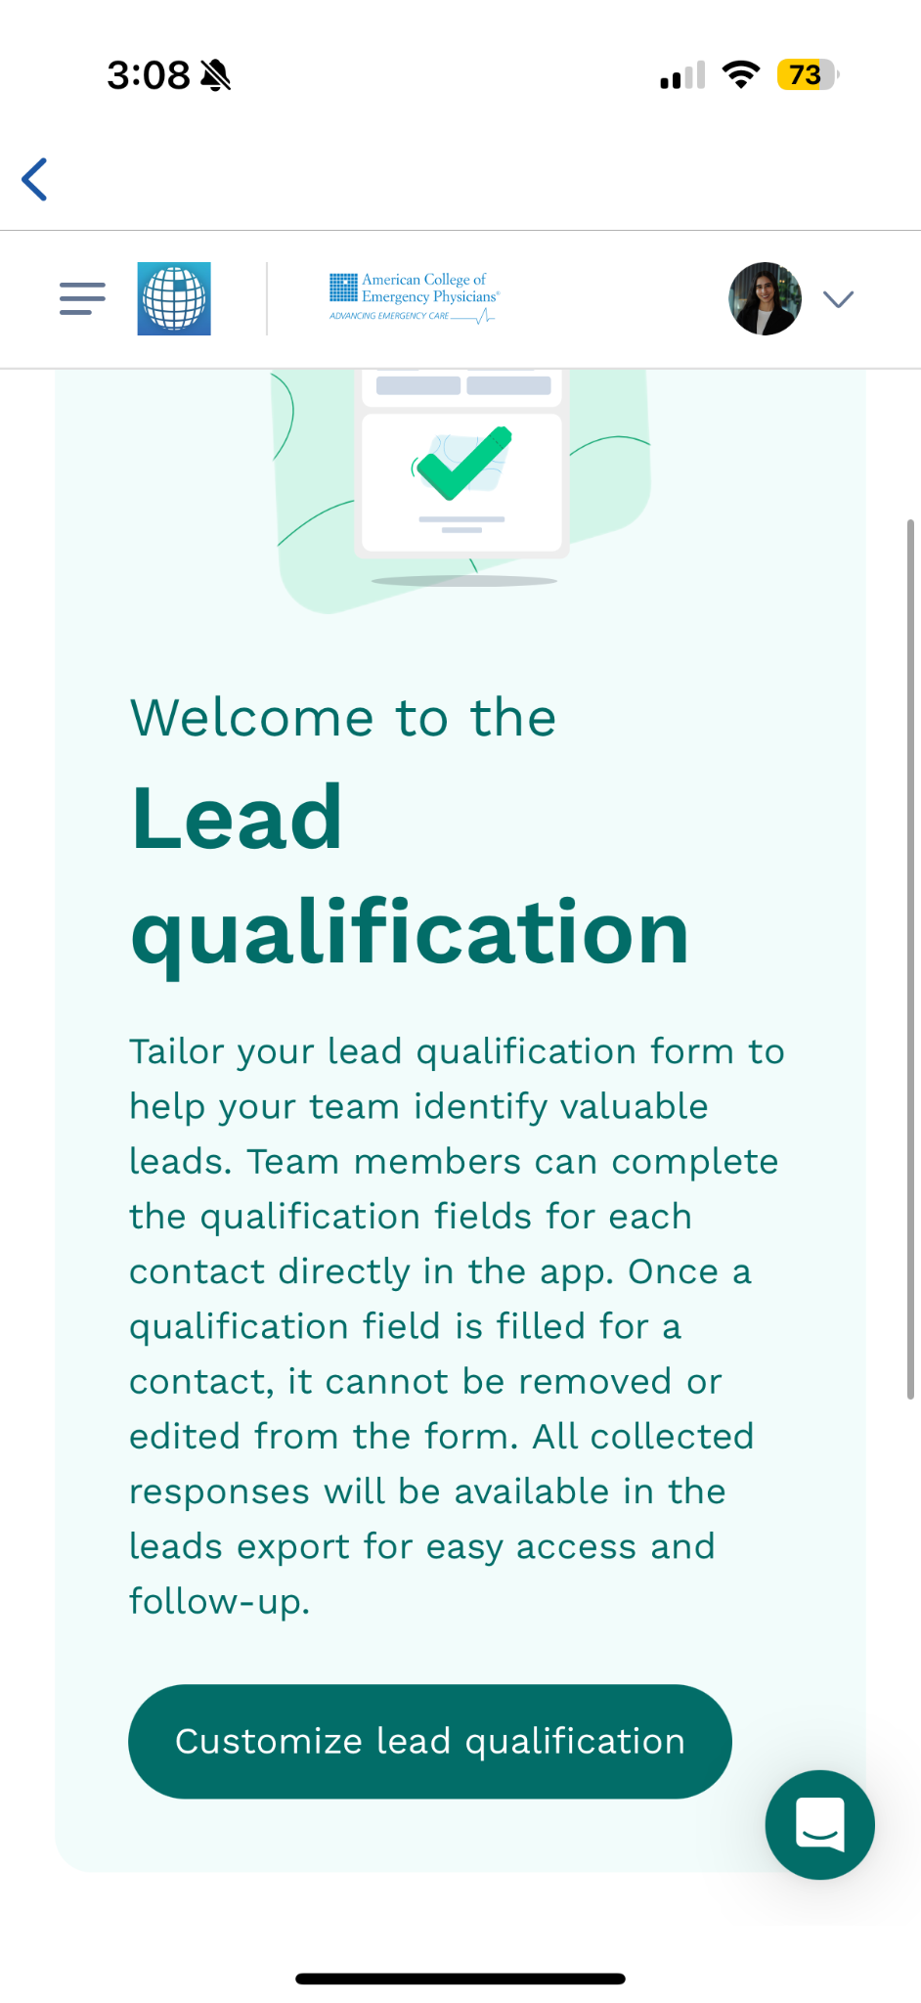
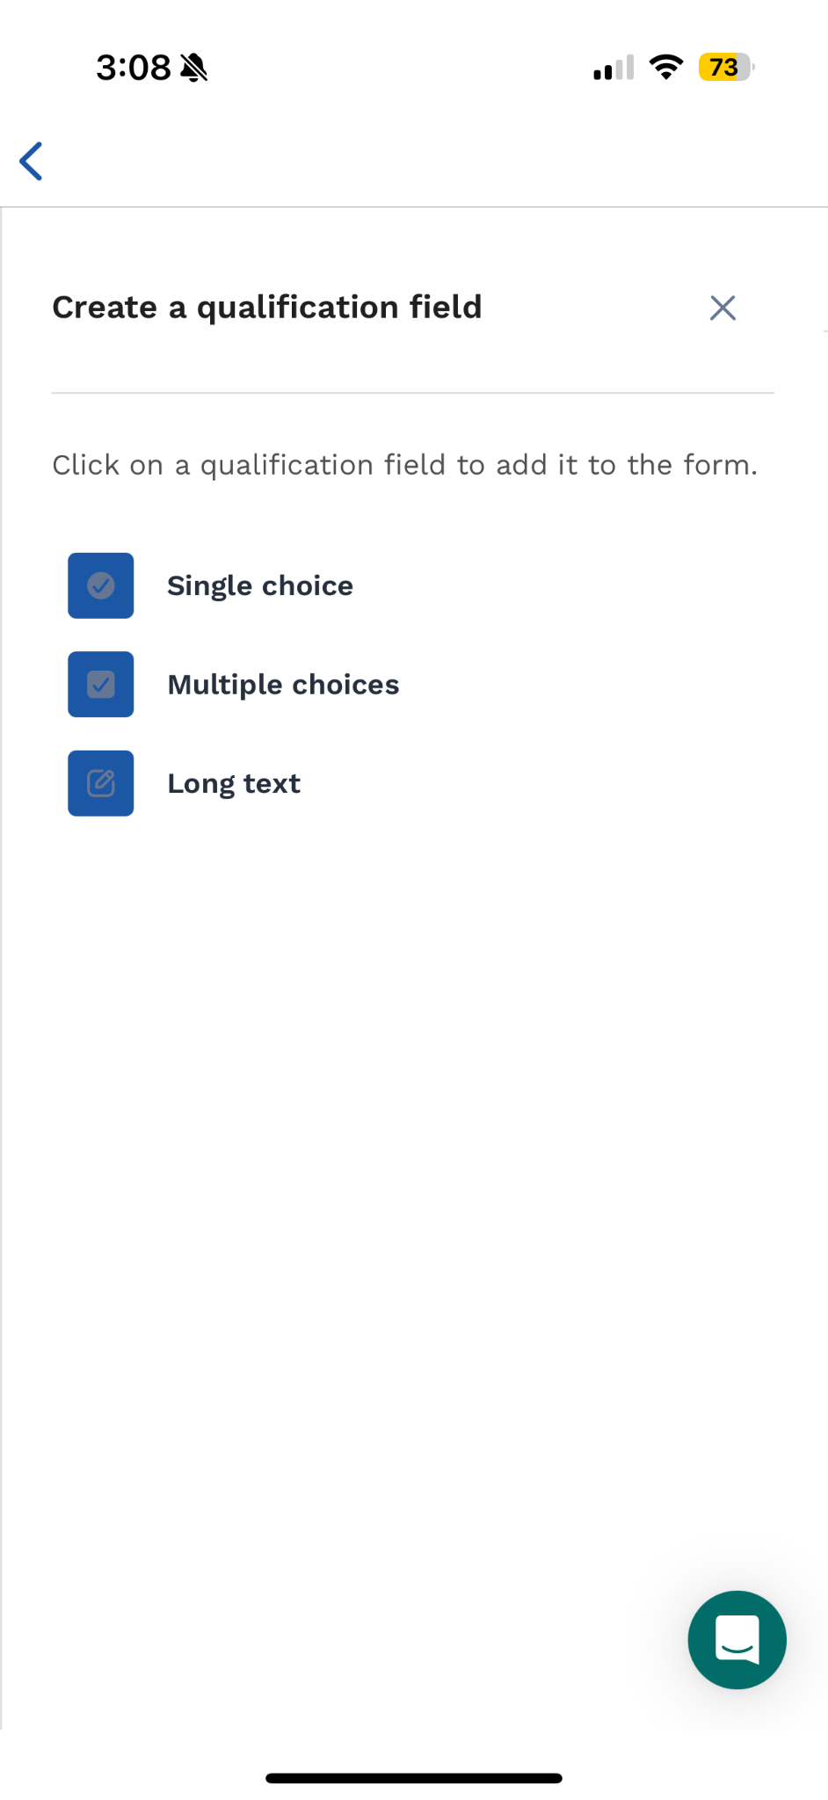
Setting custom lead qualifying questions (if you purchased this option)
1. Click on ‘Lead qualification’
2. Click on the option to customize
3. Create a qualification field: single choice, multiple choice or long text
4. You can edit the questions and values at anytime. Questions will be shared across team members

Slide 10
Scanning badges on-site

Slide 11
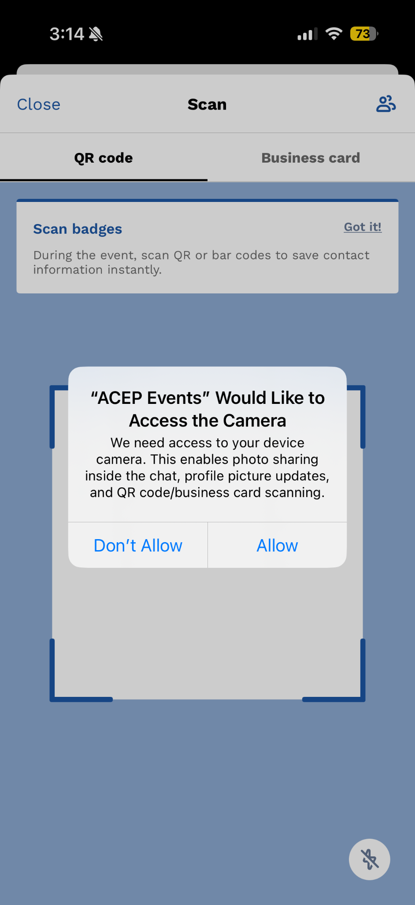
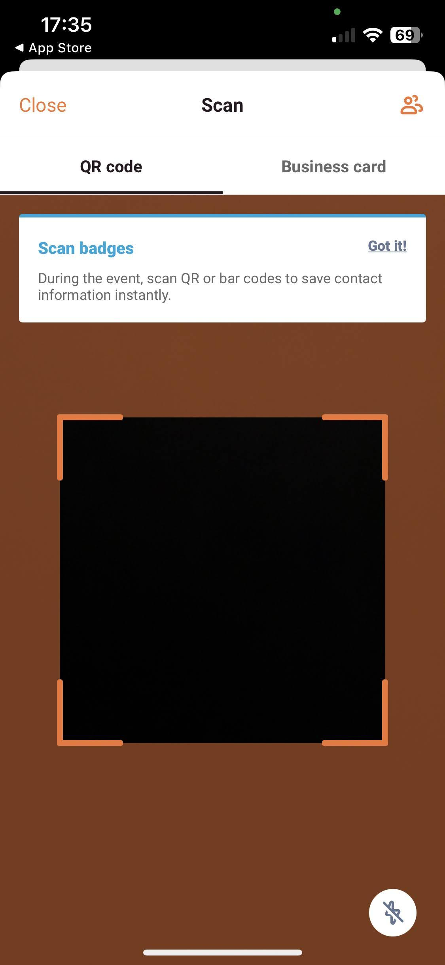
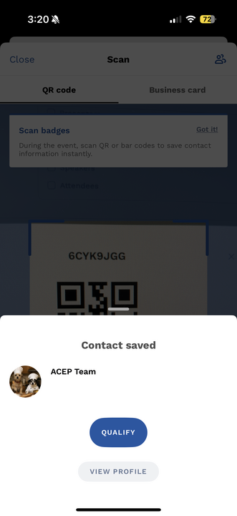
Scanning leads at the show
Step 1: Click on the scanning icon in the bottom panel
Step 2: Grant camera permissions
Step 3: Point the camera at a badge
and you have successfully captured your lead’s contact details!

Slide 12
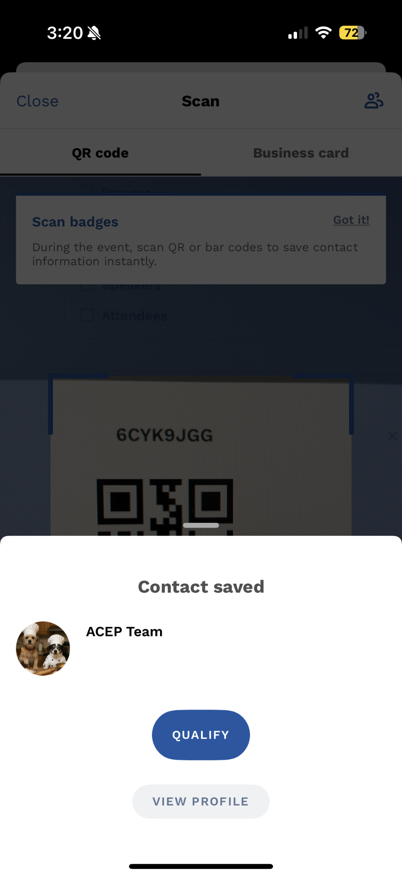
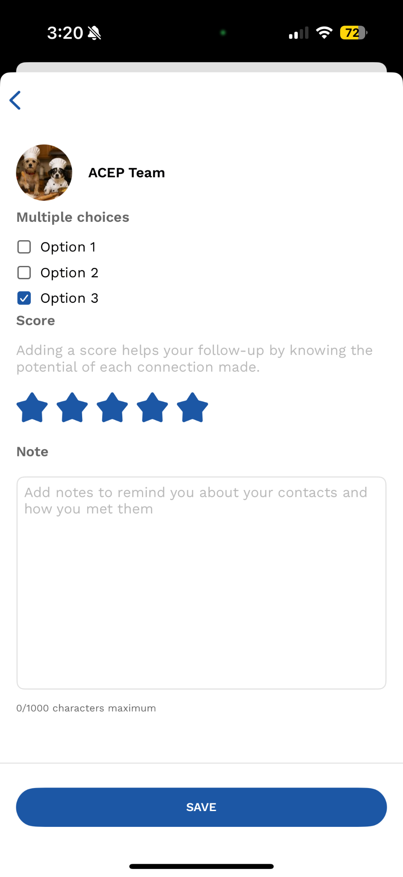
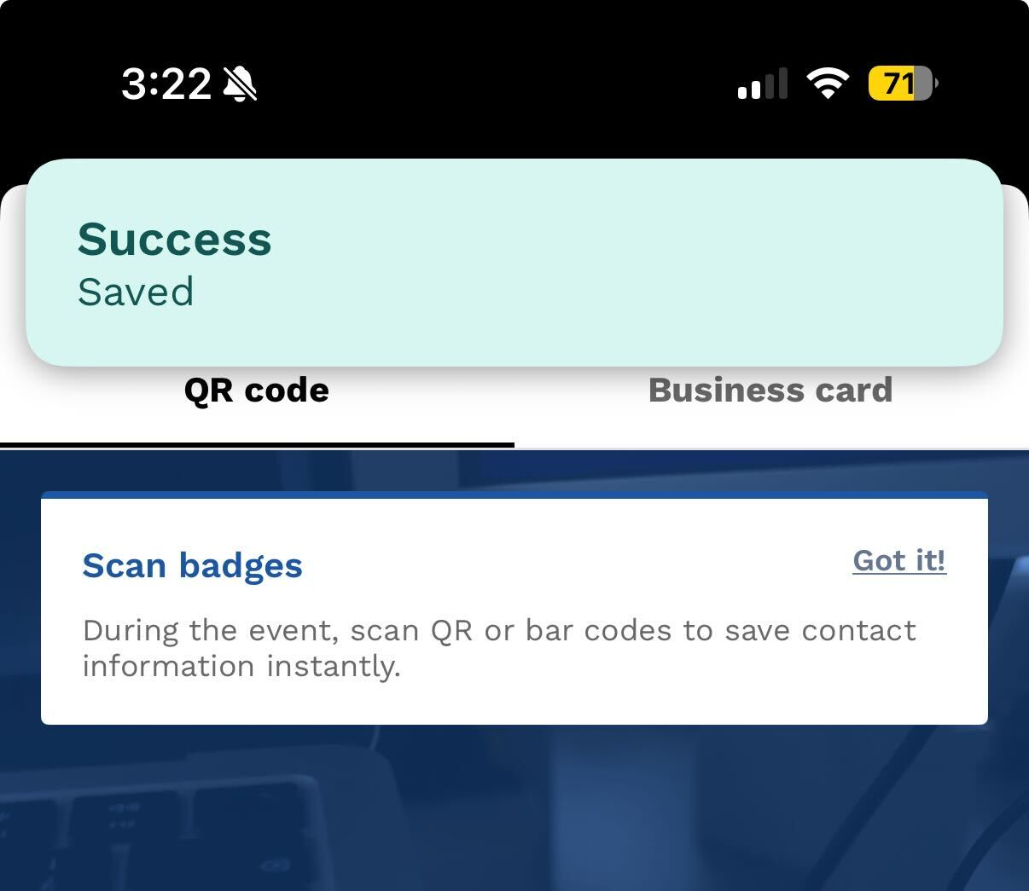
Scoring and qualifying leads generated at the show
Step 1: Score or qualify your lead’s potential
Step 2: Add notes for more details
Successfully scored!

Slide 13
Downloading leads generated at the show

Slide 14
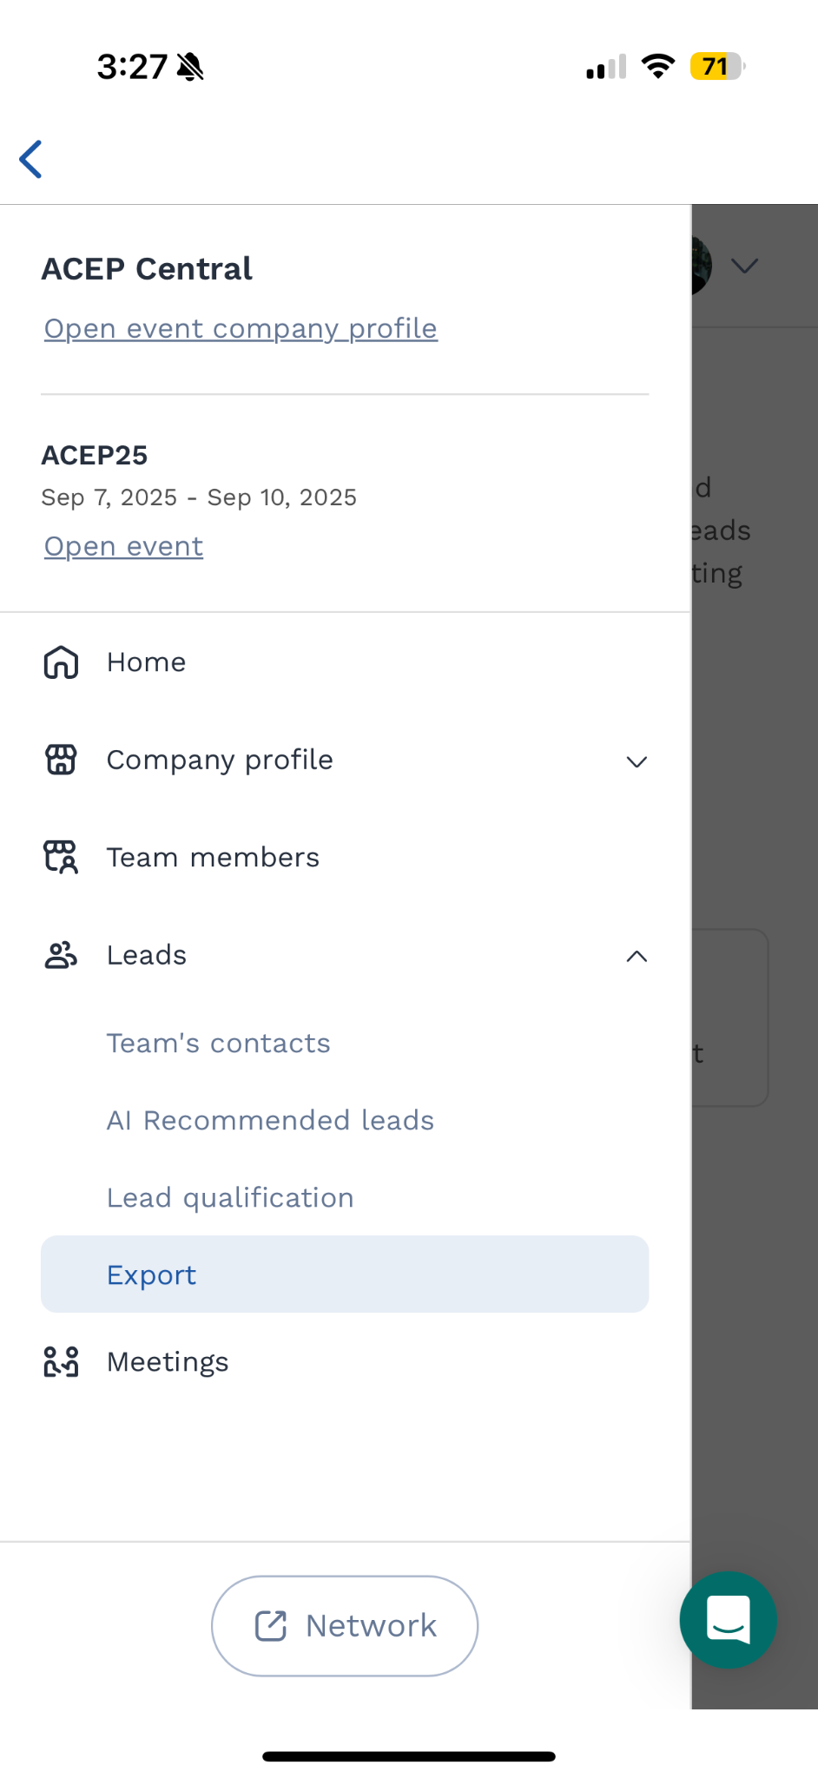
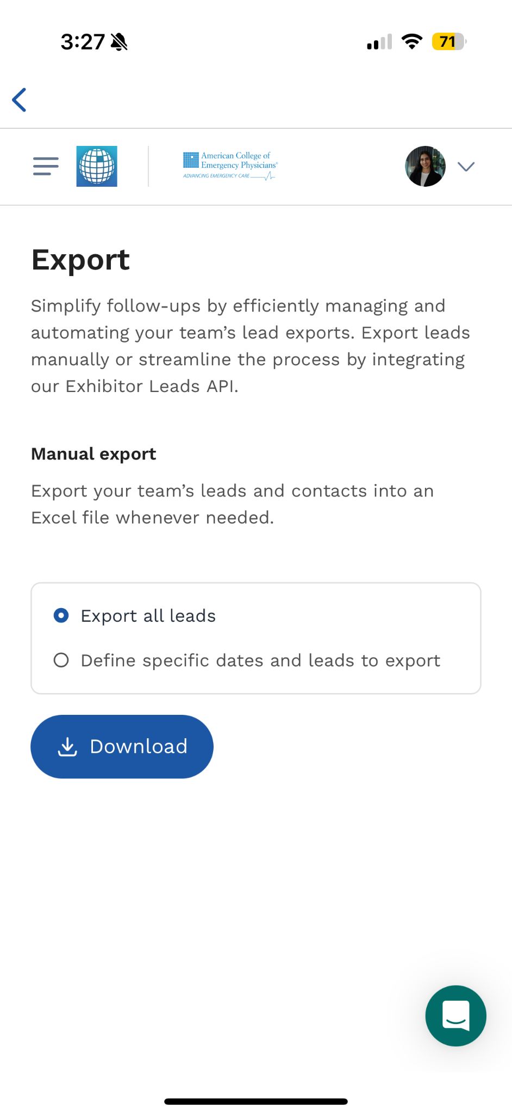
Scoring and qualifying leads generated at the show
Step 3: Click on the menu icon on the top right
Step 4: Click on ‘Export’
under Leads
Step 5: Click on ‘Download’
Step 1: Click on ‘Exhibitor Center’
Step 2: Select the event

